Slide 1
Team 3 Stratego Presentation
Parker Jones, Jesse Chen, Emily Pencek, Yosef Jacobson

Slide 2
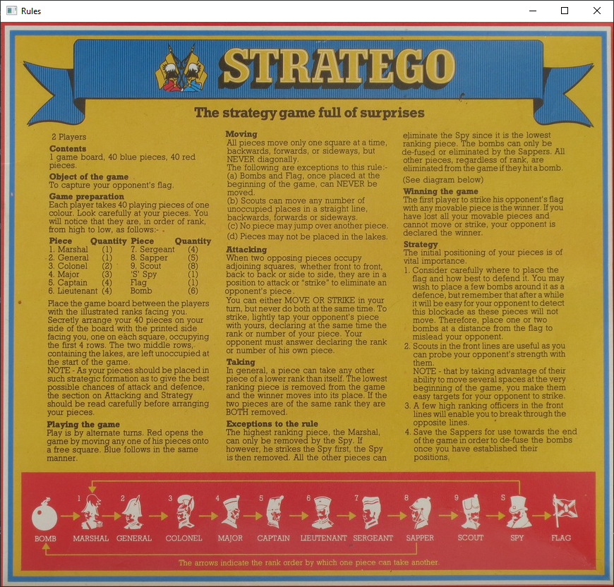
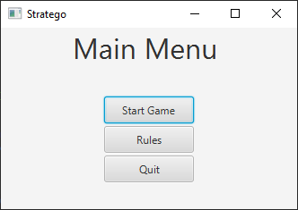
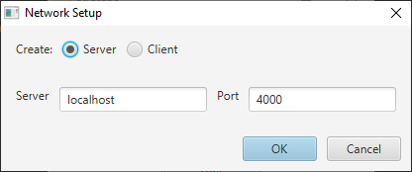
The Main Menu
Implemented as a class extending Scene; takes a StrategoView as a parameter
Holds a BorderPane with the label and all three buttons
Start Game informs the View to draw the main game window, which opens a network setup dialog that, when finished, indirectly creates the Model using the Controller.
Rules uses a simple inner class extending Stage to open a new window displaying the static rules image.

Slide 3
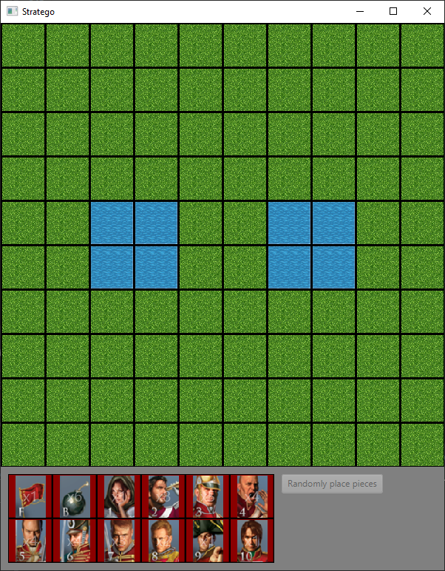
The Game View
The Controller holds the Model and handles all interaction with it, and informs the View of which tile to draw in which position on the grid.
Before a connection is established, the View shows this screen and prevents user input. The server is red team, and the client is blue team.
The Model’s board is maintained as an array of Pieces from the red player’s perspective, and is flipped by the view for the blue player.

Slide 4
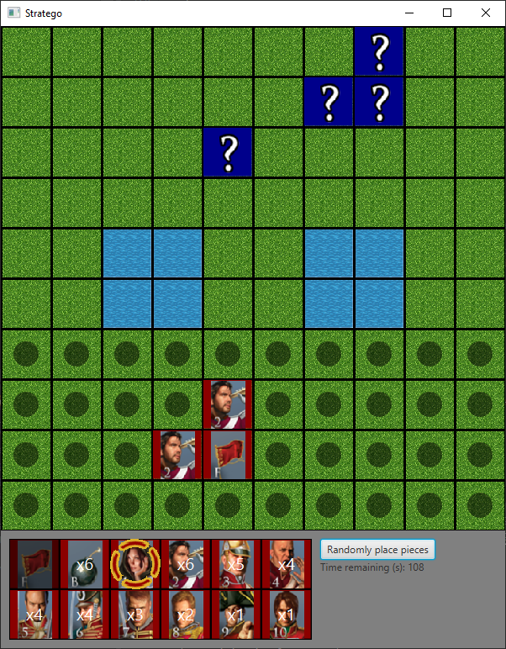
Game View (cont.)
Once a connection has been established, the players are given 2 minutes to place their pieces. This is done using a simple inner class containing a Timer.
Once the Timer reaches 0, it informs the View to automatically place any remaining pieces, and sends a BEGIN_GAME message. This informs each View to start the game phase.
Pieces can be placed by selecting the piece and then a valid tile (indicated by the black dot), or by clicking and dragging. Either way, the Controller informs the Model of which piece is placed where, and the Model sets the piece and notifies the View.

Slide 5
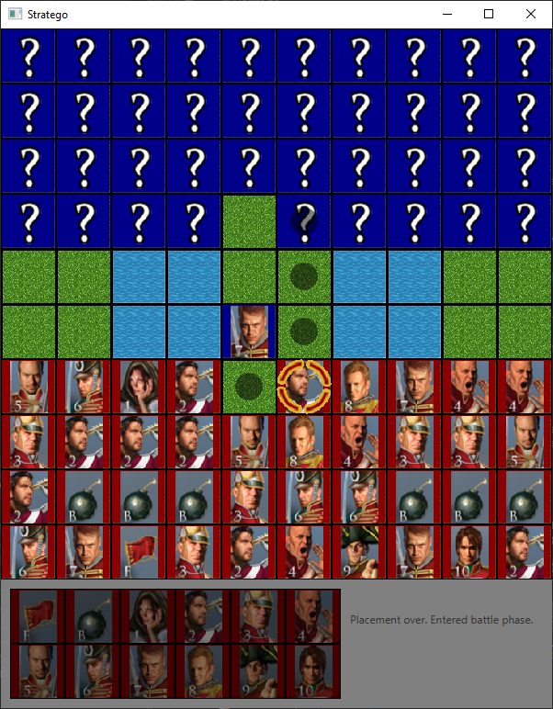
Game View (cont.)
The bottom part of the window is drawn using a class that extends GridPane.
It holds a single Piece for each available piece, and tracks the quantity remaining for each piece. These are stored in parallel arrays.
The main view is a StackPane, allowing the selected and valid move indicators (as well as the battle and game over animations) to be shown on top of the board.

Slide 6
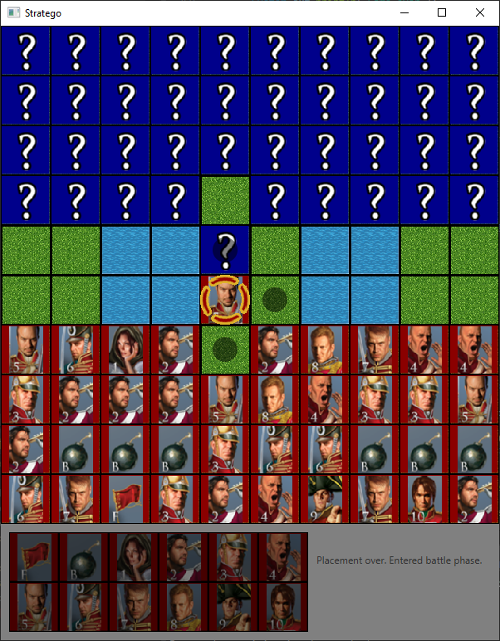
Game View (cont.)
Each Piece has booleans representing its team and whether or not it has been revealed to the other player.
When a piece is moved onto a space on the grid that is occupied by an enemy, a method in the Controller is called to calculate the result of the battle. Both pieces are revealed, and the loser is removed from the board, or both pieces are removed in the case of a tie.

Slide 7
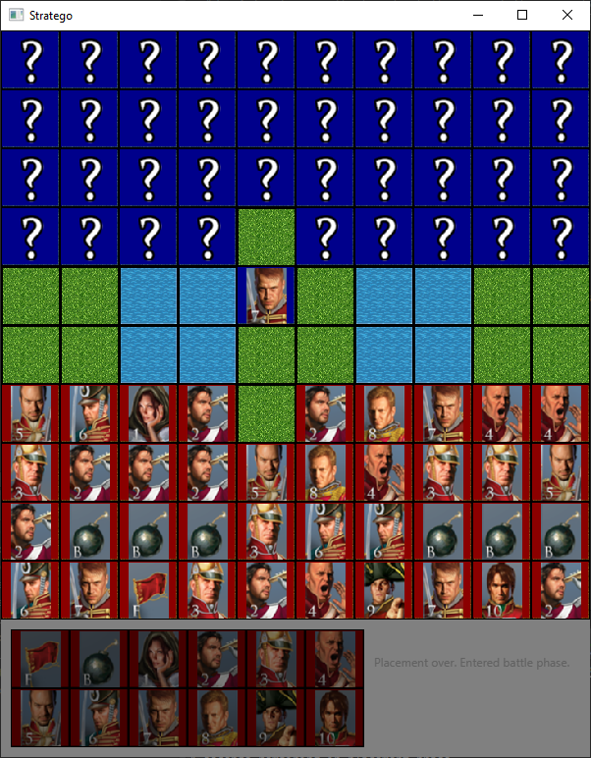
Game View (cont.)
Each Piece has booleans representing its team and whether or not it has been revealed to the other player.
When a piece is moved onto a space on the grid that is occupied by an enemy, a method in the Controller is called to calculate the result of the battle. Both pieces are revealed, and the loser is removed from the board, or both pieces are removed in the case of a tie.

Slide 8

Game View (cont.)
Whenever a Piece is selected, the View calls on the Controller to calculate its valid moves, and uses this information to display the correct valid move indicators.
Valid moves are represented as a Set<Loc>, where Loc is a class containing values for a row and column in the grid.

Slide 9
Networking
Networking is handled by a StrategoMessage class, which is extended by StrategoPieceUpdate, which is in turn extended by StrategoPieceBattle.
The base StrategoMessage class holds an enum representing the type of message, and a boolean representing the originating team.
StrategoPieceUpdate adds a from Loc and a to Loc to represent the origin and destination of the piece being updated.
StrategoPieceBattle uses the two Locs to represent the coordinates of the two pieces that battled, where the from Loc is the winner and the to Loc is the loser. It also adds a boolean representing whether the battle was a tie or not.
Whenever the game state is changed, an appropriate message is sent to the other player and handled according to the type of message and its contents.
This is done on a separate thread to avoid stalling, and a boolean is used to track whether or not it is this player’s turn. Input is disabled appropriately.

Slide 10

Wow Factor: Battle Animation

Slide 11
Wow Factor: Tie Animation

Slide 12
Wow Factor: Bomb Animation

Slide 13
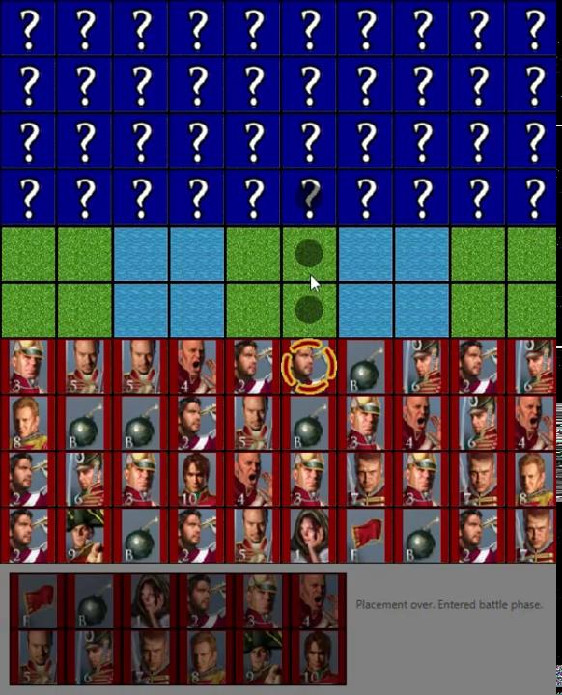
Wow Factor: Red Wins Animation

Slide 14
Wow Factor: Blue Wins Animation

